Slide 1

GRAPH THEORY AND ITS APPLICATIONS
Dr. Arti Arya
Department of Computer Science & Engineering

Slide 2

GRAPH THEORY, APPLICATIONS AND COMBINATORICS
HAMILTON GRAPHS
Dr. Arti Arya
Department of Computer Science & Engineering

Slide 3
Graph Theory and its Applications Acknowledgement
The slides are prepared by Dr. Surabhi Narayan and a lot of inputs are added by Dr. Arti Arya. The sources of the information other than textbook is mentioned wherever used.

Slide 4
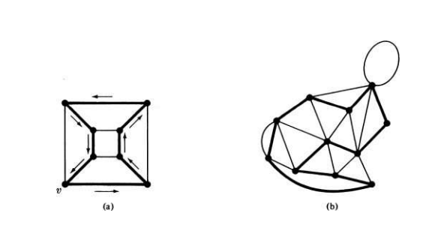
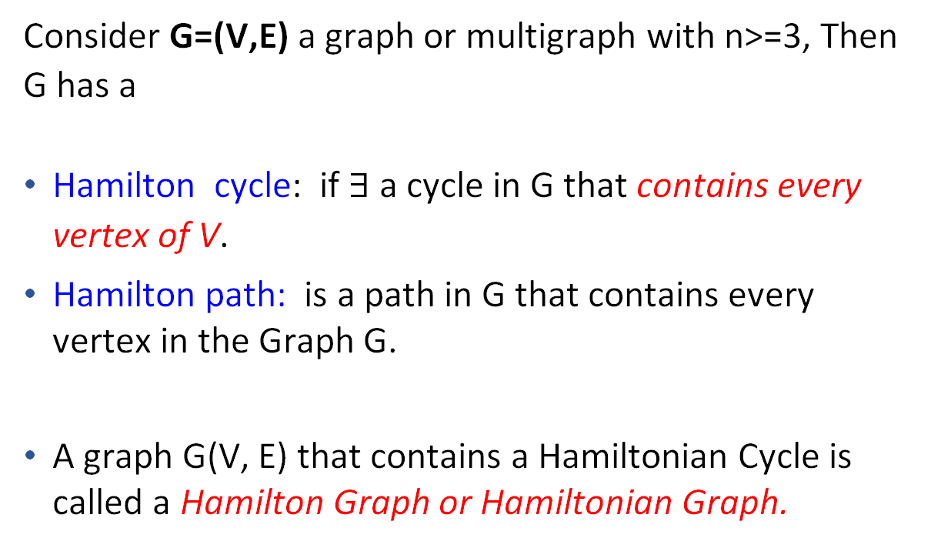
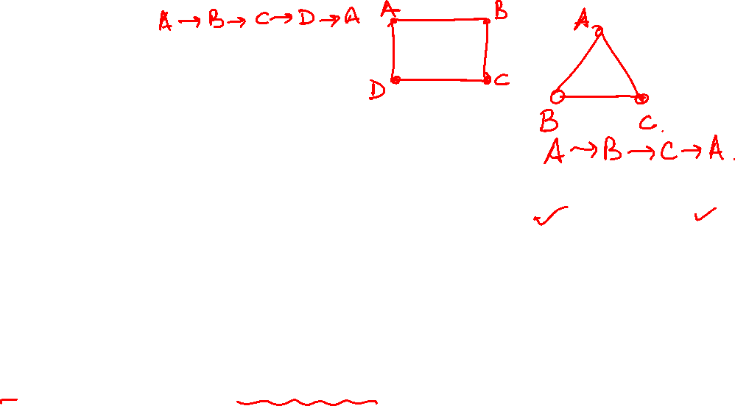
Graph Theory, Applications and Combinatorics Hamilton Graphs
Consider G=(V,E) a graph or multigraph with n>=3, Then G has a
Hamilton cycle: if $∃$a cycle in G that contains every vertex of V.
Hamilton path: is a path in G that contains every vertex in the Graph G.
A graph G(V, E) that contains a Hamiltonian Cycle is called a Hamilton Graph or Hamiltonian Graph.
In a connected graph, Length of Hamilton cycle = n and length of Hamilton path = n-1.

Slide 5
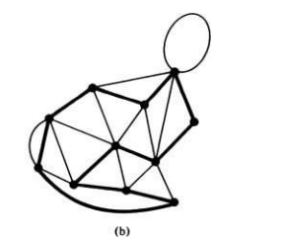
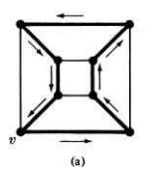
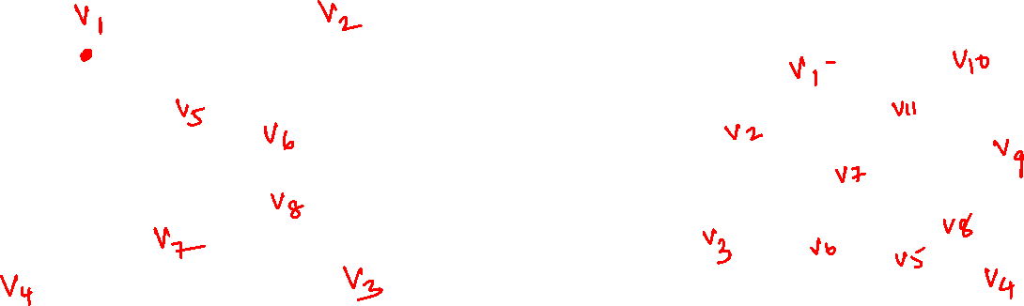
Graph Theory, Applications and Combinatorics Hamilton Graphs
A Hamiltonian circuit in a connected graph G(V,E) is defined as a closed walk that traverses every vertex of G exactly once, except of course the starting vertex, at which the walk also terminates.

Slide 6
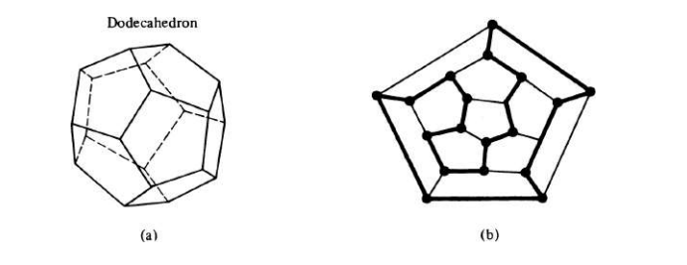
Graph Theory, Applications and Combinatorics Hamilton Graphs
A Hamiltonian circuit in a connected graph G(V,E) is defined as a closed walk that traverses every vertex of G exactly once, except of course the starting vertex, at which the walk also terminates.
v1
If we remove any one edge from the Hamilton circuit, we are left with Hamilton path.
v8
v7
v9
v5
v19
v2
v6
v18
v17
v10
v14
v16
v15
v20
v13
v12
v11
v4
v3

Slide 7
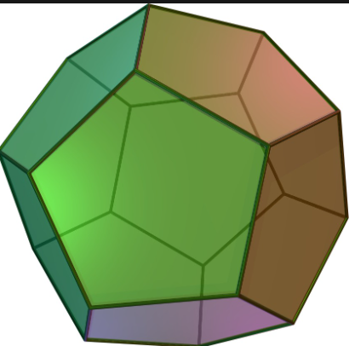
Graph Theory, Applications and Combinatorics Hamilton Graphs
In geometry, a dodecahedron or duodecahedron is any polyhedron with twelve flat faces.
A regular dodecahedron has 12 faces and 20 vertices

Slide 8
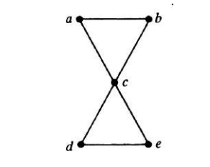
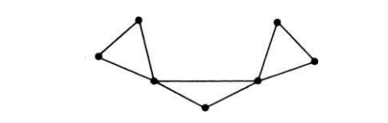
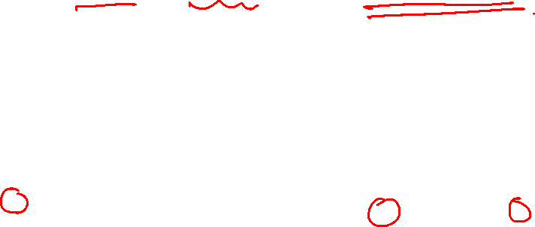
Graph Theory, Applications and Combinatorics Hamilton Graphs
A given graph may contain more than one Hamilton circuit
A Hamiltonian circuit in a graph of n vertices consists of exactly n edges.
These 2 graphs do not have a Hamilton cycle.

Slide 9
Graph Theory, Applications and Combinatorics Hamilton Graphs vs Euler’s Graph
Hamilton Graphs
A Hamiltonian graph has a Hamiltonian cycle.
A Hamiltonian cycle is a cycle that visits every vertex exactly once and returns to the starting vertex.
The focus is on visiting every vertex exactly once (Hamiltonian)
Euler’s Graph
A Eulerian graph has a Eulerian circuit.
A Eulerian circuit is a cycle that visits every edge exactly once and returns to the starting vertex.
The focus is on visiting every edge exactly once (Eulerian)

Slide 10
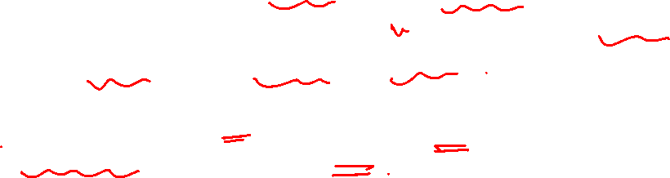
Graph Theory, Applications and Combinatorics Hamilton Graphs
A Hamiltonian path is a subgraph of a Hamiltonian circuit (which in turn is a subgraph of another graph), every graph that has a Hamiltonian circuit also has a Hamiltonian path.
There are many graphs with Hamiltonian paths that have no Hamiltonian circuits. ( Find out some such graphs)
The length of a Hamiltonian path (if it exists) in a connected graph of n vertices is n — 1.

Slide 11
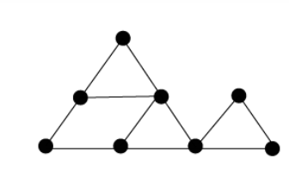
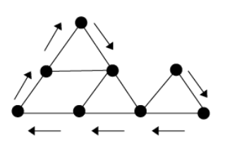

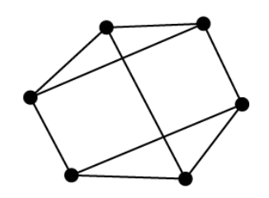
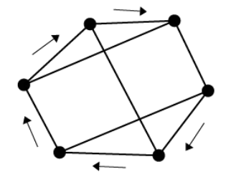


Graph Theory, Applications and Combinatorics Hamilton Graphs
v7
v6
v8
v1
v2
v5
v4
v3
https://calcworkshop.com/trees-graphs/euler-circuit-hamiltonian-path/

Slide 12
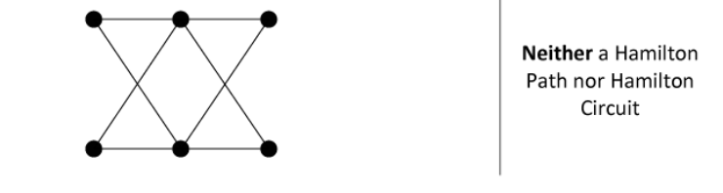
Graph Theory, Applications and Combinatorics Hamilton Graphs
https://calcworkshop.com/trees-graphs/euler-circuit-hamiltonian-path/

Slide 13
Graph Theory, Applications and Combinatorics Hamilton Graphs
What is the necessary and sufficient condition for a connected graph to have a Hamilton circuit?
This is an unsolved problem since posed by Irish Mathematician William Hamilton in 1859.

Slide 14
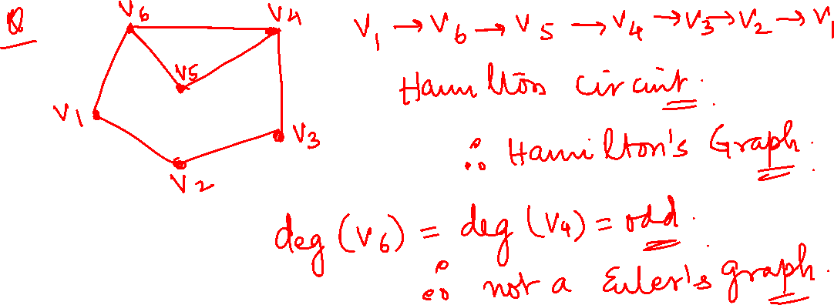
Graph Theory, Applications and Combinatorics Some quick questions on Eulerian Graph and Hamiltonian Graph

Slide 15
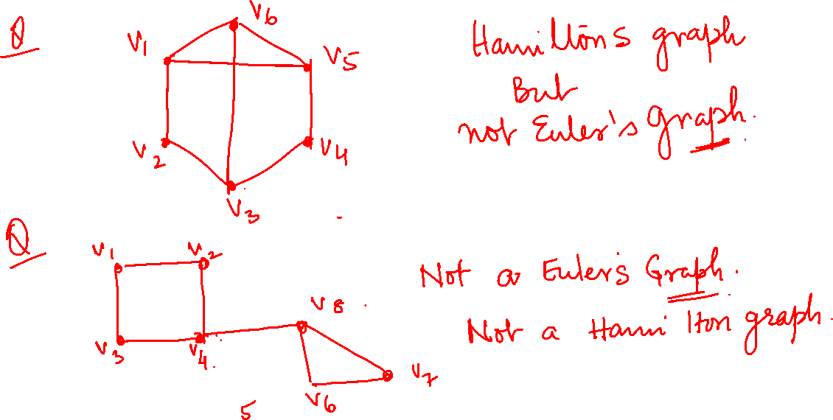
Graph Theory, Applications and Combinatorics Some quick questions

Slide 16
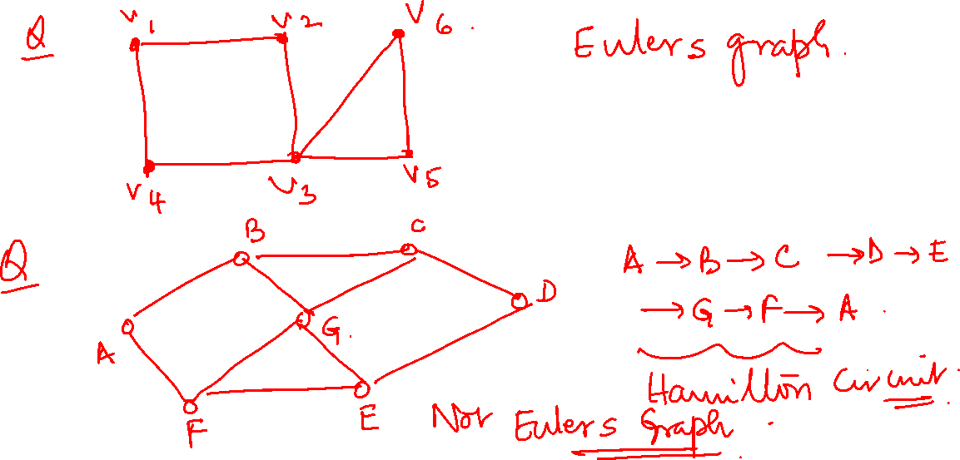
Graph Theory, Applications and Combinatorics Some quick questions

Slide 17
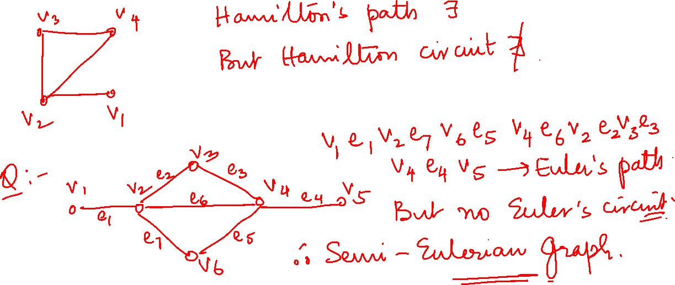
Graph Theory, Applications and Combinatorics Some quick questions

Slide 18
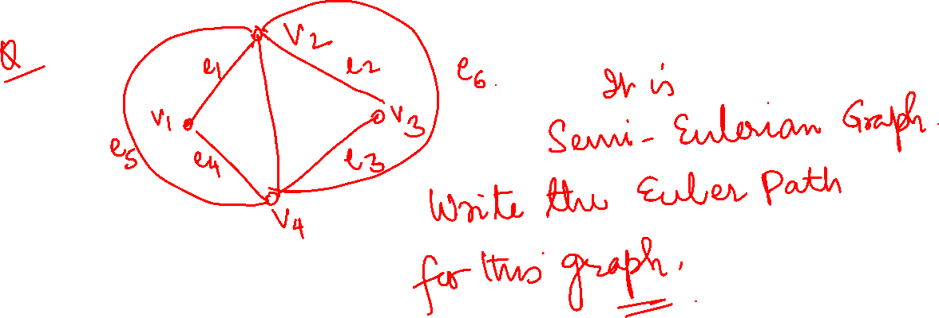
Graph Theory, Applications and Combinatorics Some quick questions

Slide 19
Graph Theory, Applications and Combinatorics Some quick questions

Slide 20
Graph Theory, Applications and Combinatorics Some quick questions

Slide 21
Graph Theory, Applications and Combinatorics Some quick questions

Slide 22
Graph Theory, Applications and Combinatorics Some quick questions

Slide 23

Graph Theory, Applications and Combinatorics Hamilton Graphs
Dirac’s theorem
If in a simple connected graph with n vertices n>=3, 𝛿(G) is >=n/2 then the graph is Hamiltonian.
OR
A sufficient (but not necessary) condition for a simple connected graph G to have a Hamilton circuit is that the degree of every vertex in G be at least n/2 ( n = # of vertices)

Slide 24
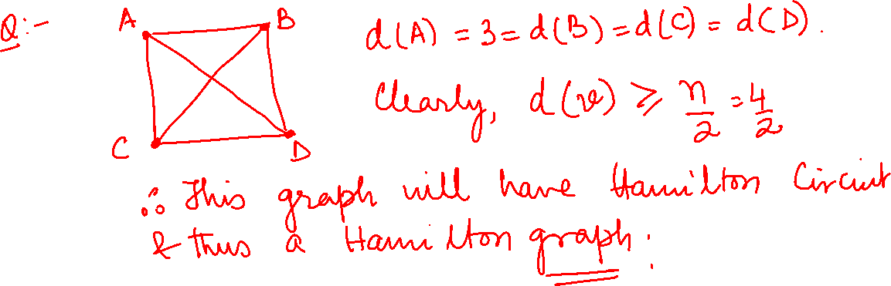
Graph Theory, Applications and Combinatorics Some quick questions on Dirac’s Theorem

Slide 25
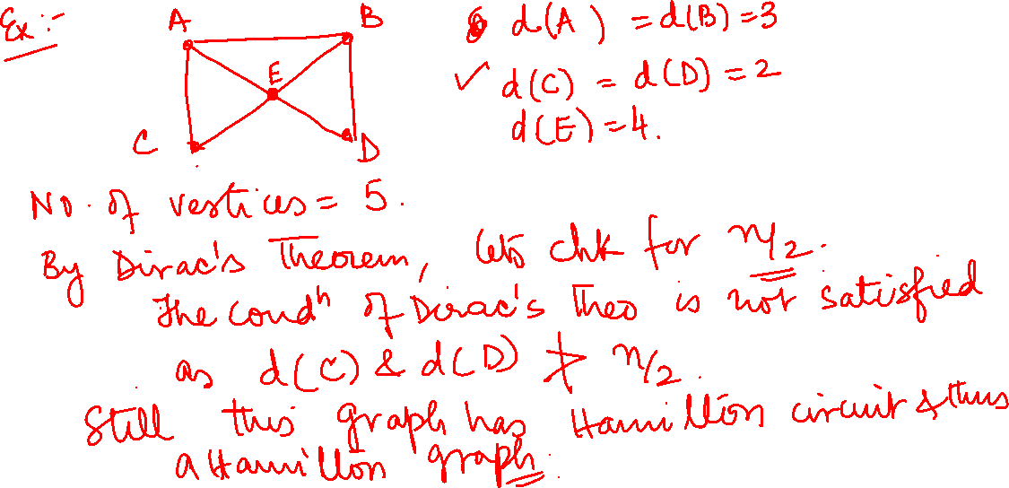
Graph Theory, Applications and Combinatorics Some quick questions on Dirac’s Theorem

Slide 26
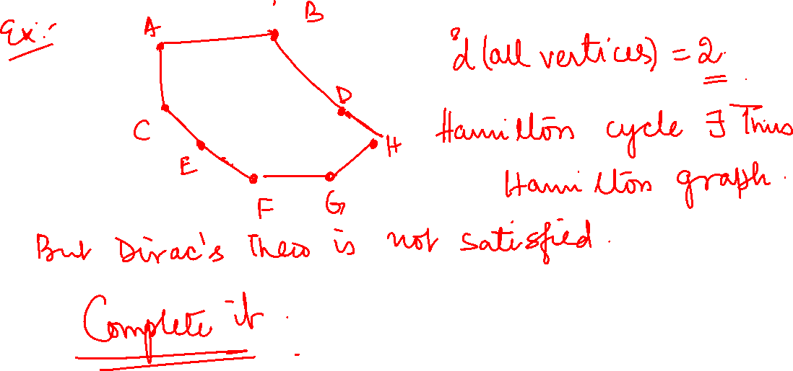
Graph Theory, Applications and Combinatorics Some quick questions on Dirac’s Theorem

Slide 27
Graph Theory, Applications and Combinatorics Hamilton Graphs
Below is a graph representing friendships between a group of students (each vertex is a student and each edge is a friendship). Is it possible for the students to sit around a round table in such a way that every student sits between two of their friends? What does this question have to do with paths?
http://sites.science.oregonstate.edu/~kovchegy/math355winter2020/HW8key.pdf

Slide 28
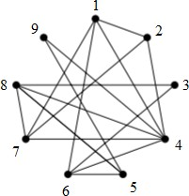
Graph Theory, Applications and Combinatorics Hamilton Graphs
Below is a graph representing friendships between a group of students (each vertex is a student and each edge is a friendship). Is it possible for the students to sit around a round table in such a way that every student sits between two of their friends? What does this question have to do with paths?
The cycle {1, 2, 4, 9, 5, 6,
3, 8, 7, 1 } is a Hamilton cycle.
http://sites.science.oregonstate.edu/~kovchegy/math355winter2020/HW8key.pdf

Slide 29
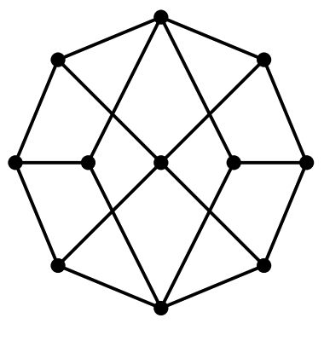
Graph Theory, Applications and Combinatorics Hamilton Graphs
Consider the following graph:
Find a Hamilton path. Can your path be extended to a Hamilton cycle?
.

Slide 30
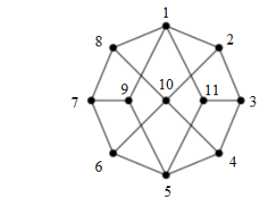
Graph Theory, Applications and Combinatorics Hamilton Graphs
There are many correct answers for a Hamilton path on this graph. If we label each vertex like this:
An example of one Hamilton path on this graph is {2, 1, 11, 3, 4, 10, 8, 7, 9, 5, 6}.
This path cannot be extended to a Hamilton cycle.

Slide 31
Graph Theory, Applications and Combinatorics Hamilton Graphs
(b) Is the graph bipartite? If so, how many vertices are in each “part”?
Use your answer to part (b) to prove that the graph has no Hamilton cycle

Slide 32
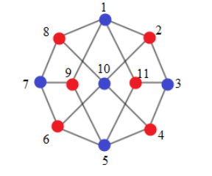
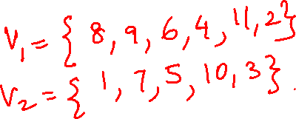
Graph Theory, Applications and Combinatorics Hamilton Graphs
(b) Is the graph bipartite? If so, how many vertices are in each “part”?
Use your answer to part (b) to prove that the graph has no Hamilton cycle
Yes, the graph is bipartite:
V1 ={1, 3, 5, 7, 10} and V2 ={2, 4, 6, 8, 9, 11}. There are 5 and 6 vertices in each part.

Slide 33
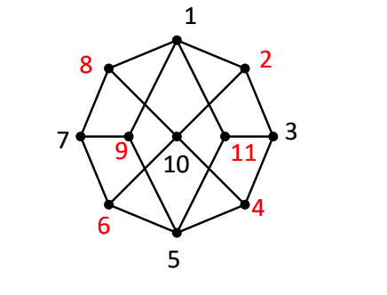
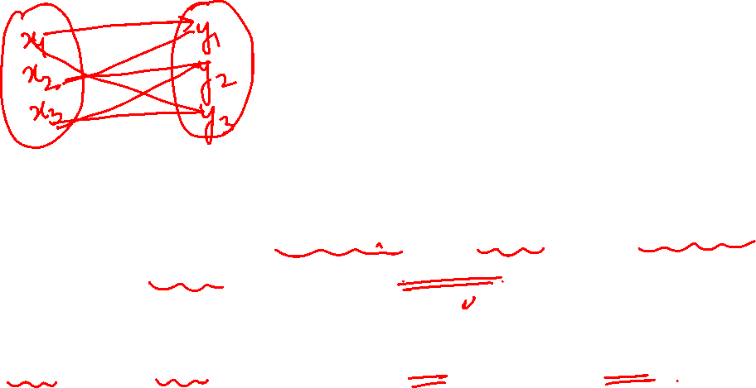
Graph Theory, Applications and Combinatorics Hamilton Graphs
Important to note that any bipartite graph that has a Hamiltonian cycle must have the same number of vertices in V1 and V2, otherwise it will be impossible to create a cycle that alternates between vertices in V1 and V2 that starts and ends at the same vertex.
But |V1| = 5 and |V2| = 6, so there can’t be a Hamilton cycle in this graph.

Slide 34
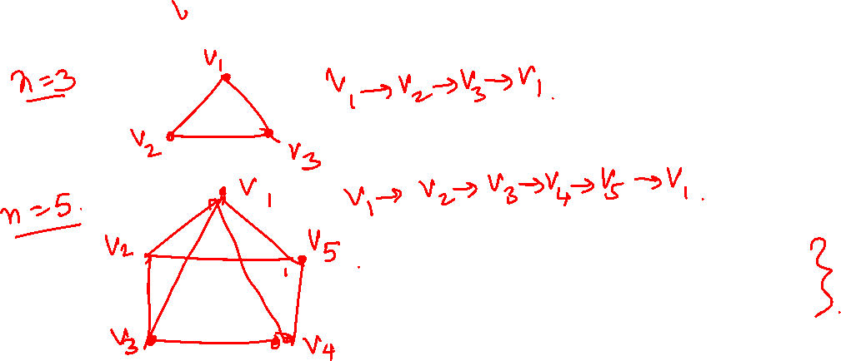
Graph Theory, Applications and Combinatorics Hamilton Graphs
For which n does K_{n} contain a Hamilton cycle? A Hamilton path? Explain.
For all n ≥ 3, K_{n} will contain a Hamilton cycle.
K_{n} can be considered as a regular polygon with n vertices and n sides. Since each vertex is connected to the other n−1 vertices, there is a path around the perimeter of the polygon that visits each vertex and arrives back at the starting vertex for all n ≥ 3.

Slide 35
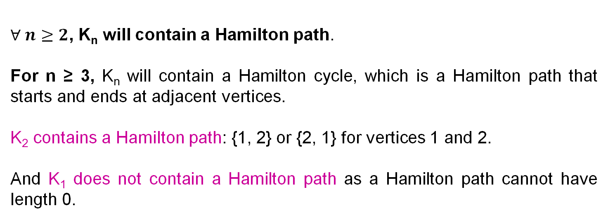
Graph Theory, Applications and Combinatorics Hamilton Graphs
For which n does K_{n} contain a Hamilton path? A Hamilton cycle? Explain.
$∀ n≥2$, K_{n} will contain a Hamilton path.
For n ≥ 3, K_{n} will contain a Hamilton cycle, which is a Hamilton path that starts and ends at adjacent vertices.
K₂ contains a Hamilton path: {1, 2} or {2, 1} for vertices 1 and 2.
And K₁ does not contain a Hamilton path as a Hamilton path cannot have length 0.

Slide 36
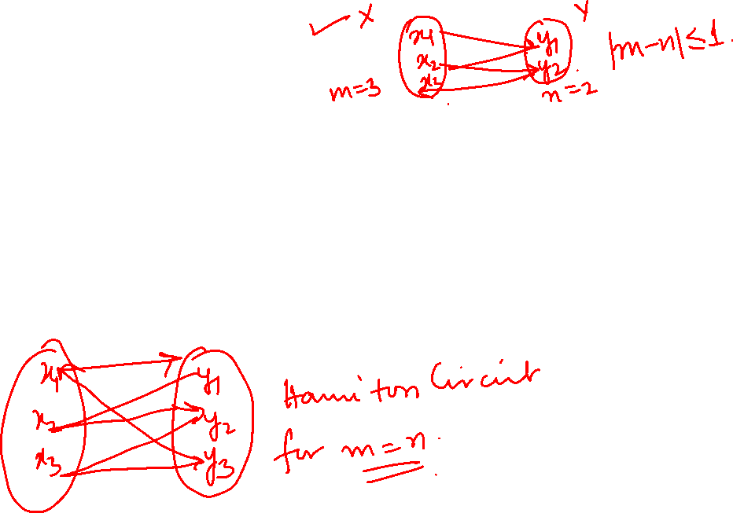
Graph Theory and its Applications
Hamilton Graphs
Q: For which m and n does the graph K_{m,n} contain a Hamilton path? A Hamilton cycle? Explain.
Solution:
As long as |m−n|≤1, the graph K_{m,n} will have a Hamilton path.
To have a Hamilton cycle, we must have m=n.

Slide 37

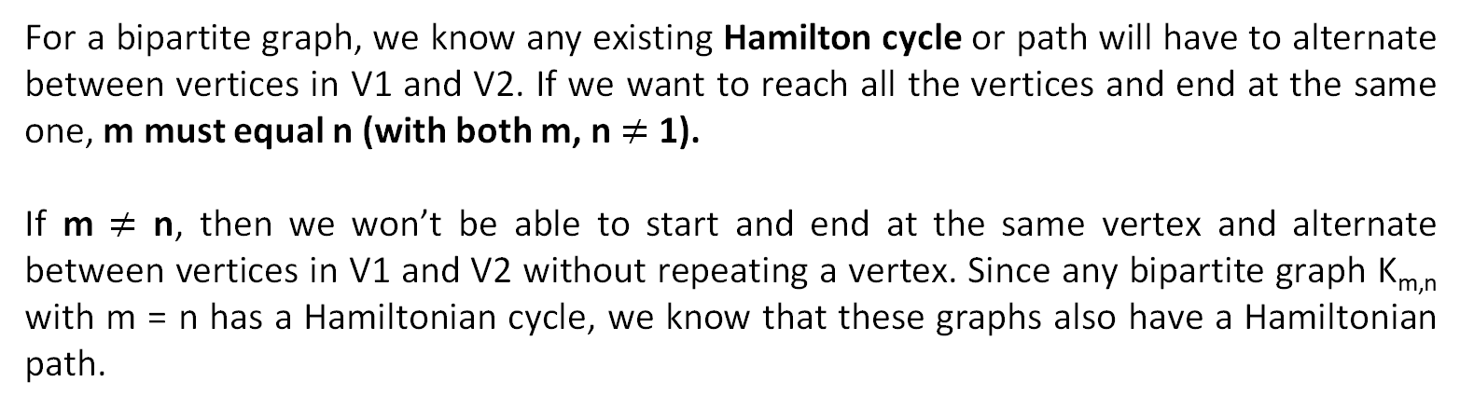
Graph Theory, Applications and Combinatorics Hamilton Graphs
Q: For which m and n does the graph K_{m,n} contain a Hamilton path? A Hamilton cycle? Explain.
Solution:
For a bipartite graph, we know any existing Hamilton cycle or path will have to alternate between vertices in V1 and V2. If we want to reach all the vertices and end at the same one, m must equal n (with both m, n $≠$ 1).
If m $≠$ n, then we won’t be able to start and end at the same vertex and alternate between vertices in V1 and V2 without repeating a vertex. Since any bipartite graph K_{m,n} with m = n has a Hamiltonian cycle, we know that these graphs also have a Hamiltonian path.

Slide 38
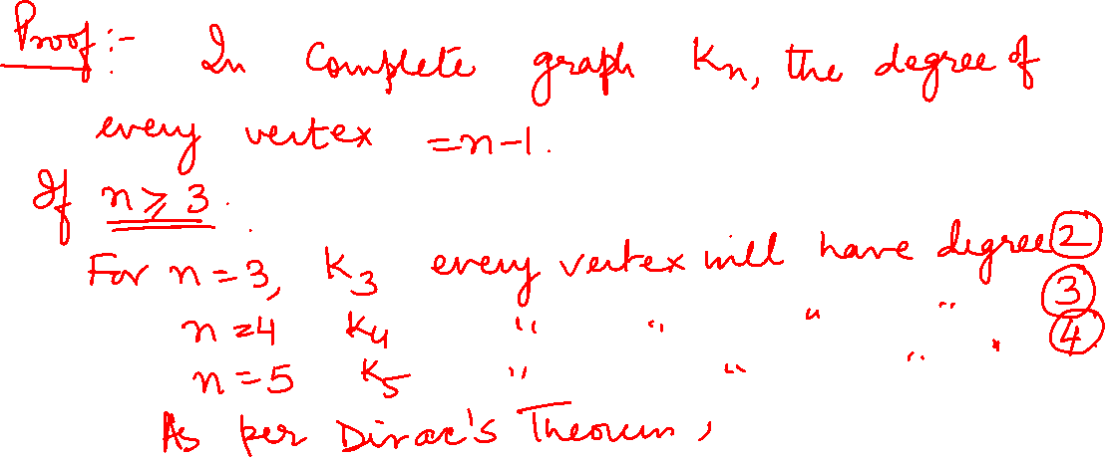
Graph Theory, Applications and Combinatorics Hamilton Graphs
Prove that the complete graph K_{n} where n>=3 is a Hamilton graph

Slide 39
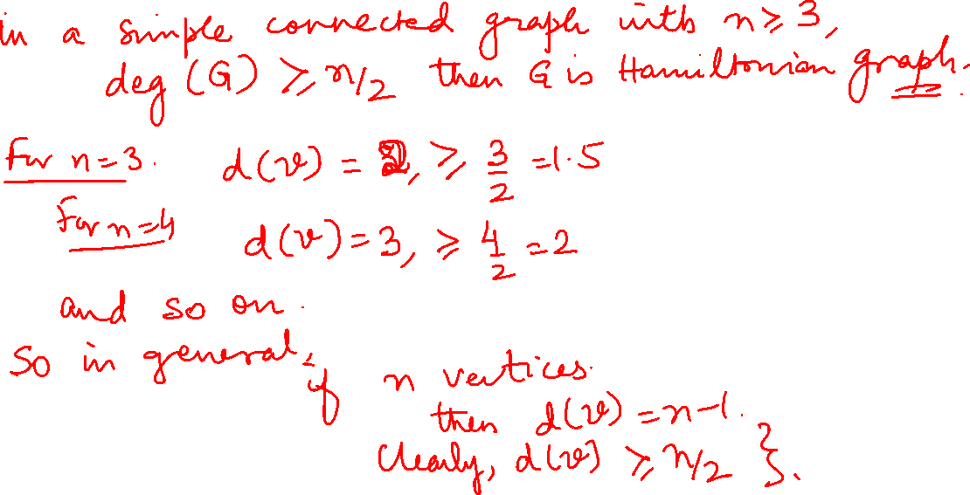

Slide 40
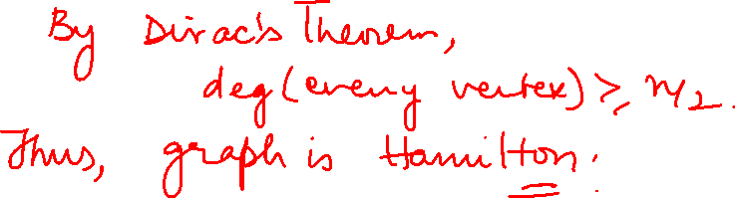

Slide 41

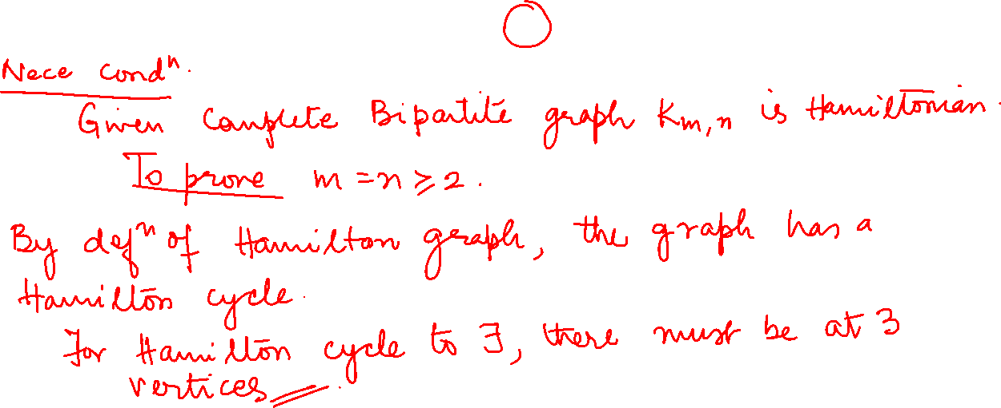
Graph Theory, Applications and Combinatorics Hamilton Graphs
The complete bipartite graph K_{m,n} is Hamiltonian iff $m=n ≥2$

Slide 42
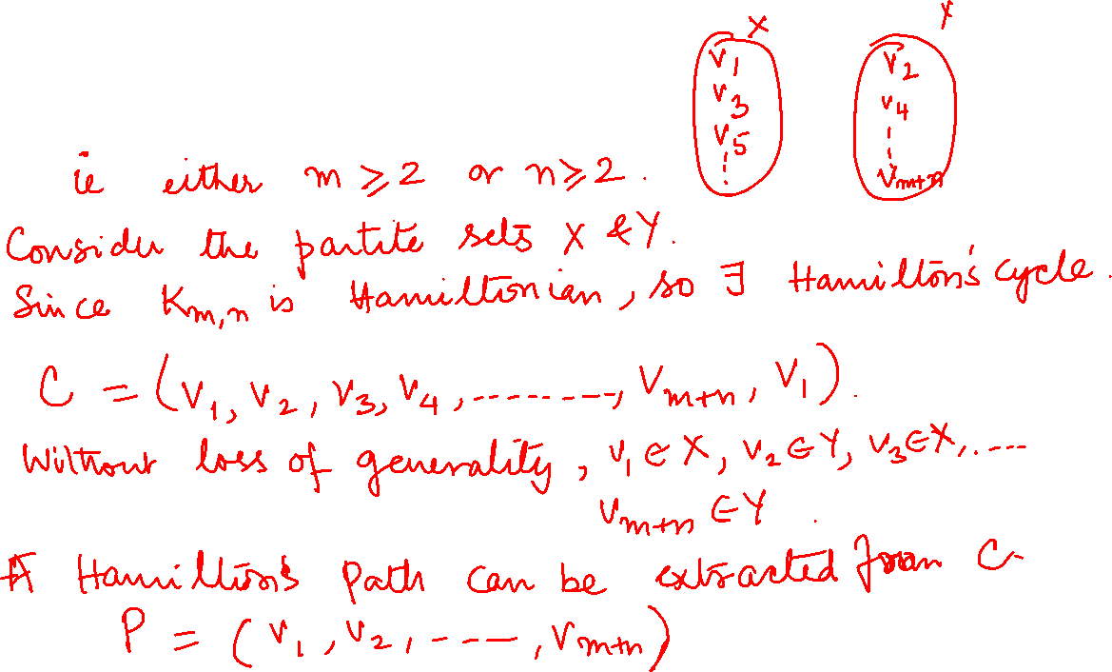
Graph Theory, Applications and Combinatorics Hamilton Graphs

Slide 43
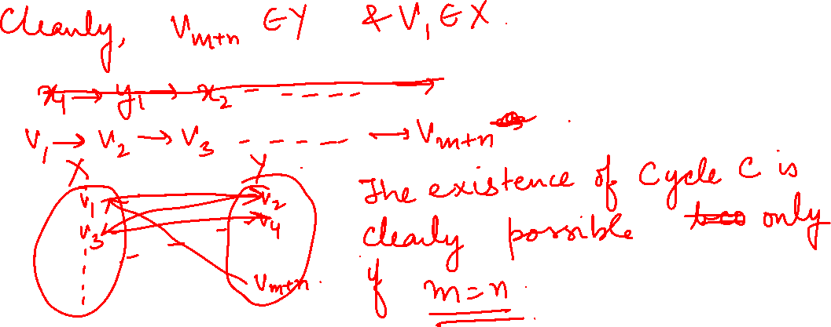
Graph Theory, Applications and Combinatorics Hamilton Graphs

Slide 44
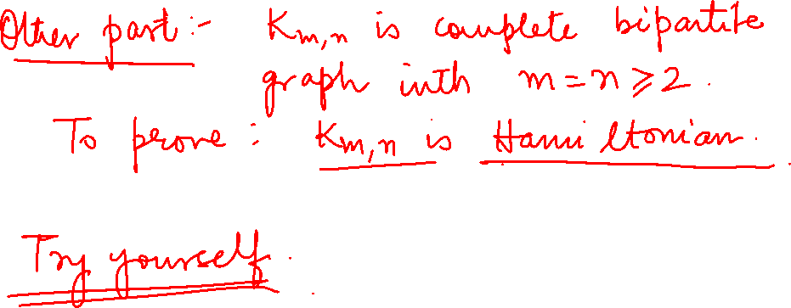
Graph Theory, Applications and Combinatorics Hamilton Graphs

Slide 45
Graph Theory, Applications and Combinatorics Hamilton Graphs

Slide 46
Graph Theory, Applications and Combinatorics Hamilton Graphs
Show that the number of Hamilton cycles in a complete bipartite graph kn,n is ½(n-1)!n! for (n>=2)
How many different Hamilton paths are there in kn,n?

Slide 47

Graph Theory, Applications and Combinatorics Hamilton Graphs
Is it Hamiltonian

Slide 48
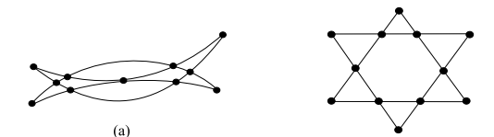
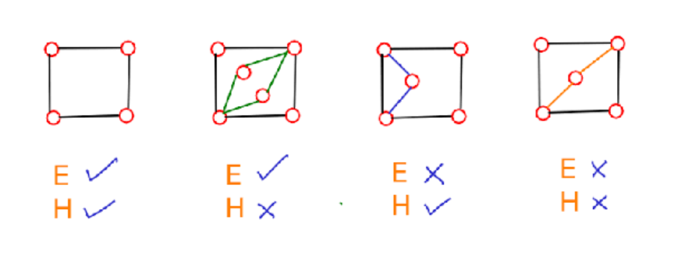
Eulers Graphs

Slide 49
THANK YOU
Dr. Arti Arya
Department of Computer Science &Engineering
artiarya@pes.edu

